Slide 1

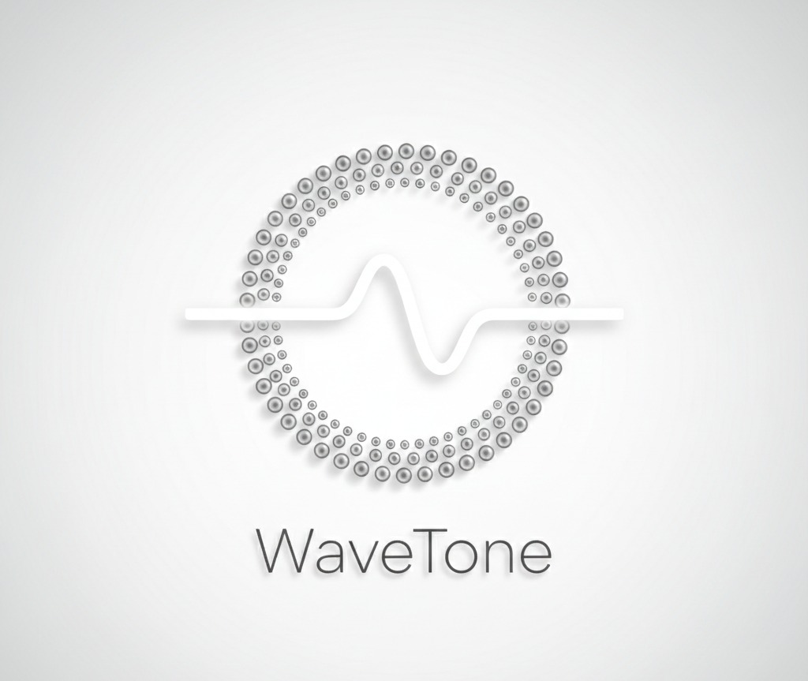
MINI PROJECT II/III YEAR
WaveTone
Problem Statement Title- Anonymous Moderated Voice Communication Platform
PS Category- Software
Student Name- Suneet Chugh, Yasharth Shrinet, Vishnu Bhatt
Guide Name: Sachin Singh

Slide 2
WaveTone
Proposed Solution
Anonymous real-time voice room platform
Peer-to-peer communication using WebRTC
Built-in moderation without storing identity or audio.
Detailed Explanation
Users join temporary voice rooms with aliases (Echo, Wave, Drift)
Audio is buffered and filtered in real-time
Moderation is rule-based + optional AI assistance
Innovation & Uniqueness
Latency-aware audio buffering (400ms)
Selective profanity suppression (not full mute)
Governance without identity (session-based system)

Slide 3
TECHNICAL APPROACH
Technologies Used
Frontend: React.js, Vite
Backend: Node.js, Express.js
Database: MongoDB Atlas
Real-time: WebRTC + Socket.io
APIs: Web Audio API, Web Speech API, Groq (For AI Summary)
Methodology / Flow
User joins room → session ID generated
WebRTC establishes peer connections
Audio passes through buffer pipeline
Profanity detected → segment muted
Warnings / vote-kick handled via server

Slide 4
Implementation
Key Modules
Voice Room (WebRTC communication)
Audio Pipeline (buffer + filtering)
Moderation System (warnings, vote-kick)
Room Management (create/join/leave)
AI Summary Module

Slide 5
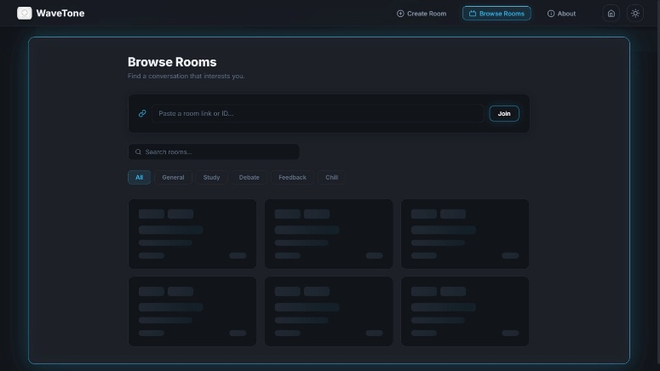
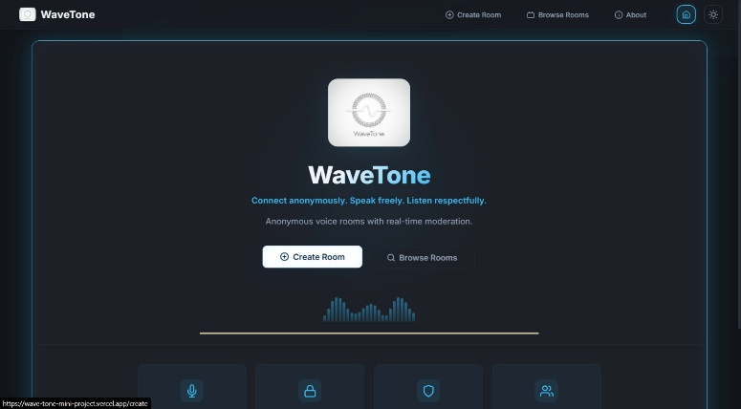
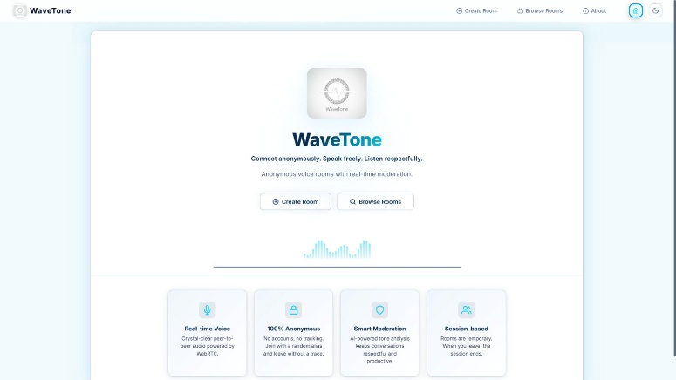
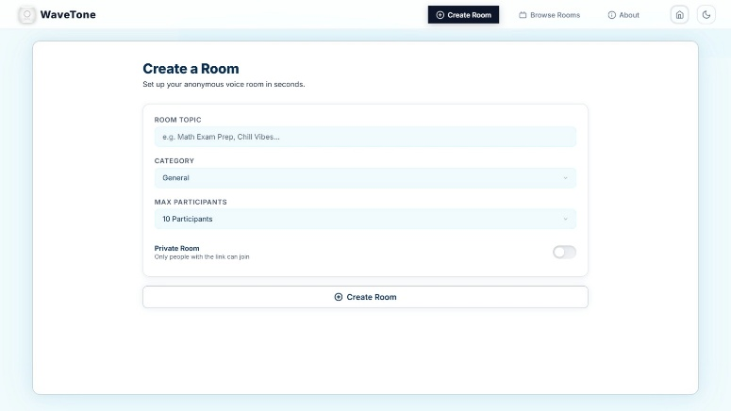
Results
Performance
Latency maintained under ~600ms
Supports up to 10 users per room
Real-time moderation without server audio processing

Slide 6
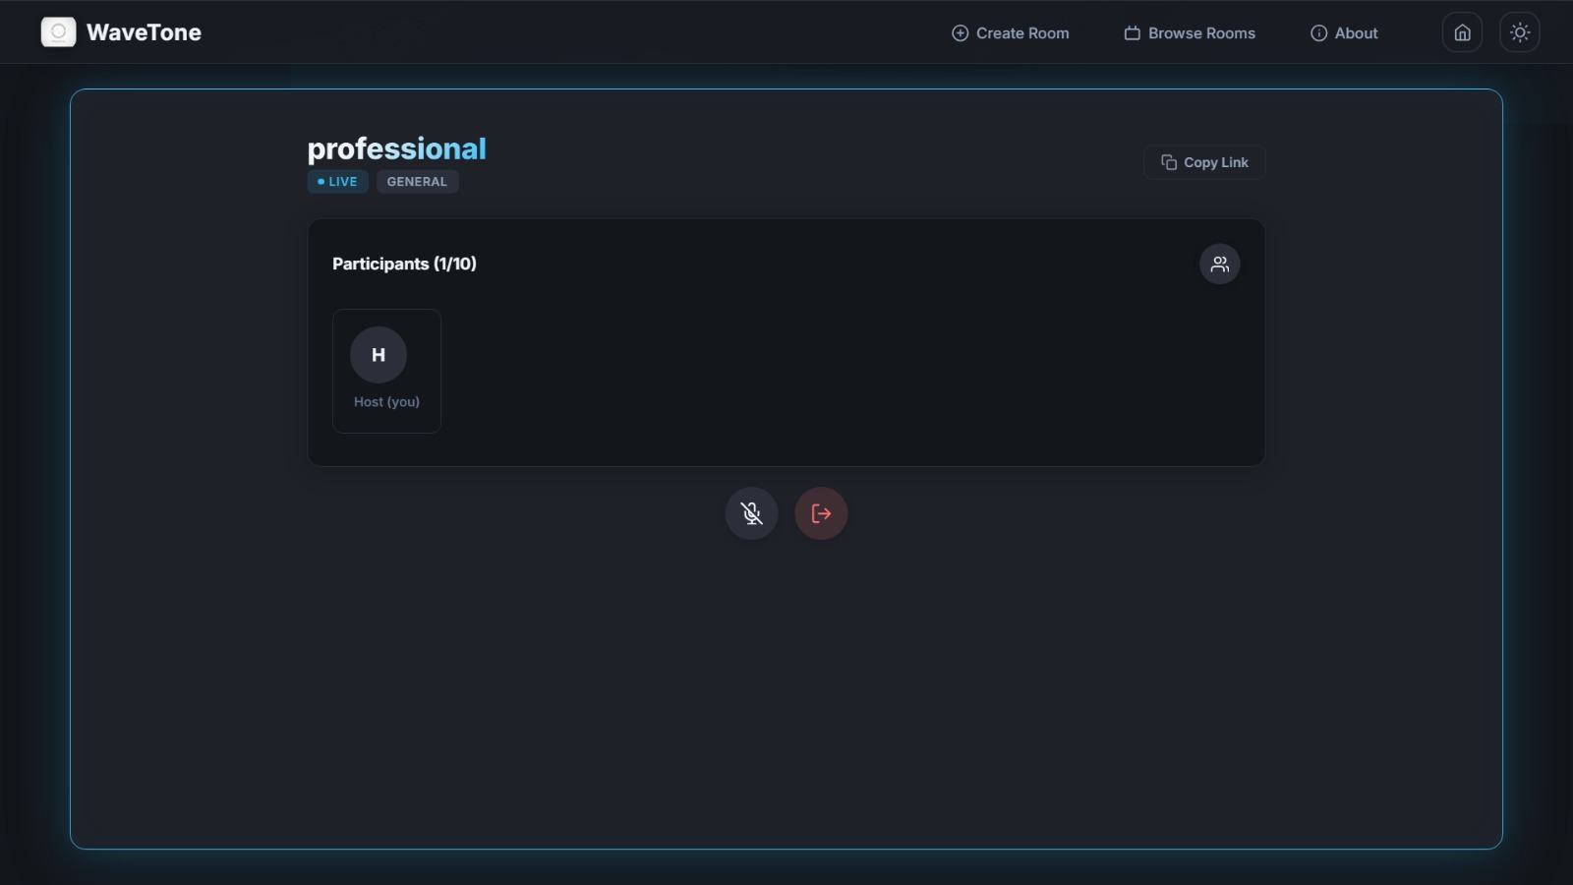
FEASIBILITY AND VIABILITY
Feasibility
Uses browser-native APIs (WebRTC, Audio API)
No heavy infrastructure required
Scalable for multiple rooms
Challenges
Browser compatibility issues
Speech recognition inaccuracies
Peer connection scaling
Solutions
Fallback for unsupported browsers
Server-side governance backup
Limit users to 10 per room

Slide 7
IMPACT AND BENEFITS
Impact
Enables safe anonymous discussions
Useful for study groups, debates, feedback sessions
Benefits
Privacy-first communication
No data storage (audio not saved)
Reduced toxicity via moderation
Economic / Social
Low-cost deployment
Promotes respectful communication

Slide 8
Limitation
No mobile app (web-only)
Speech Recognition not supported in all browsers
Client-side filtering can be bypassed
No host transfer (currently)
Mesh WebRTC limits scalability

Slide 9

RESEARCH AND REFERENCES
WebRTC Documentation (Google Developers)
Socket.io Docs
MongoDB Atlas Docs
Web Audio API (MDN)
Google Gemini API Docs
Web Speech API (MDN)

